Slide 1


2024
KITSAP COUNTY BENEFITS
Lunch + Learn
MEDICAL | DENTAL | VISION

Slide 2
Key Terms
Deductible:
Amount a policyholder is required to pay in total, before insurance begins to share claims costs through co-insurance
Co-Insurance:
After the deductible value has been met, then insurance shares the cost of any claim by a dedicated percentage. Insurance will pay a portion of the claim total and the policyholder will pay the remainder portion
Out of Pocket Maximum:
The most a policyholder will pay for covered healthcare services (co-pays, prescriptions, deductibles, and co-insurance portions. Once the Out of Pocket Max is reached, the insurance company will pay all costs for the covered dependents on the medical plan

Slide 3

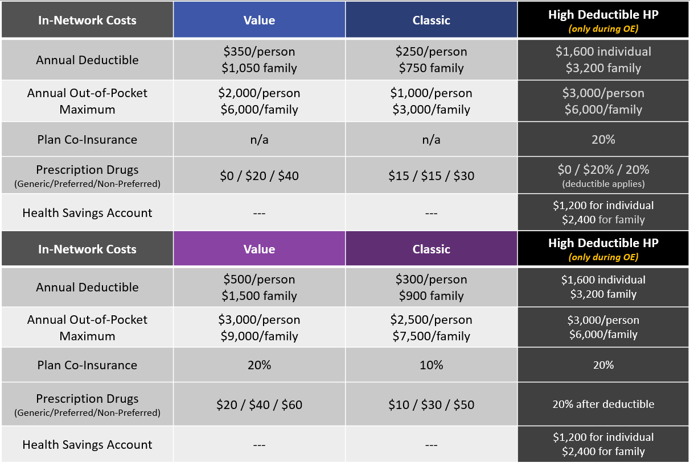


Slide 4
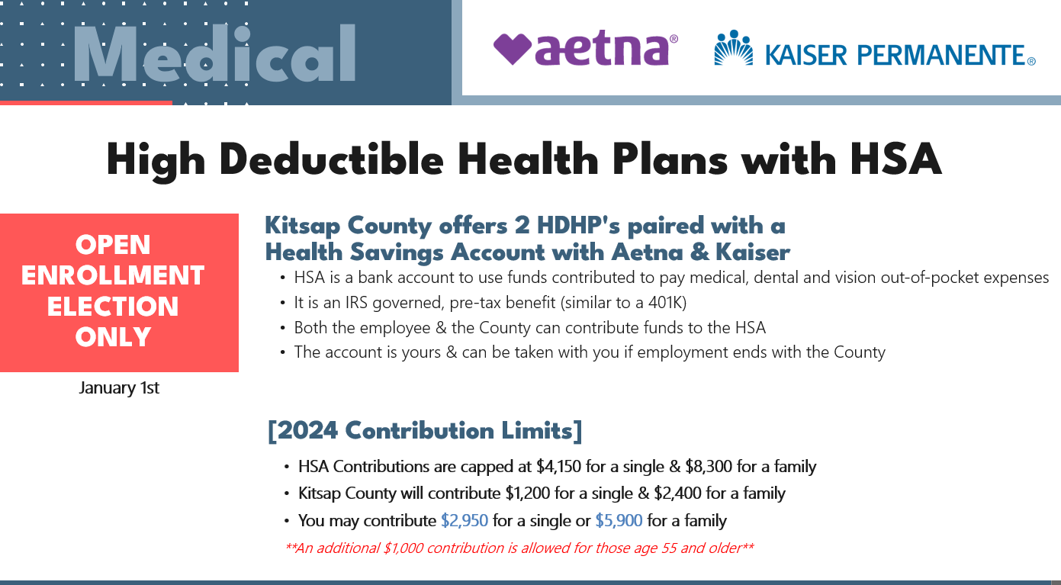
Curious How Much Per Pay Period?
Single Max: $122/pp
Family Max: $245/pp

Slide 5
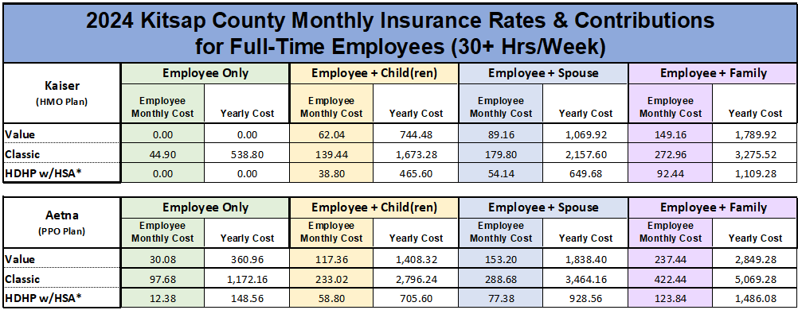
2024 Medical Rates

Slide 6

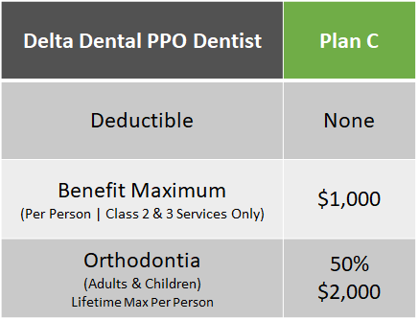
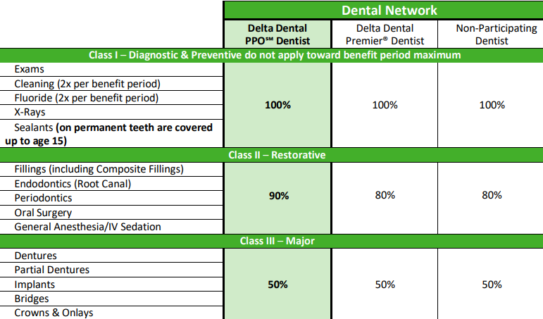
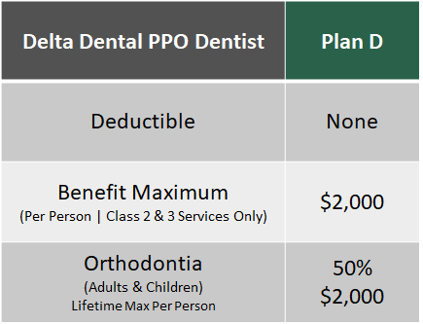
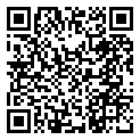
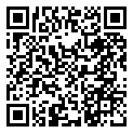
Dental
PLAN C
PLAN D
PLAN C
PLAN D

Slide 7

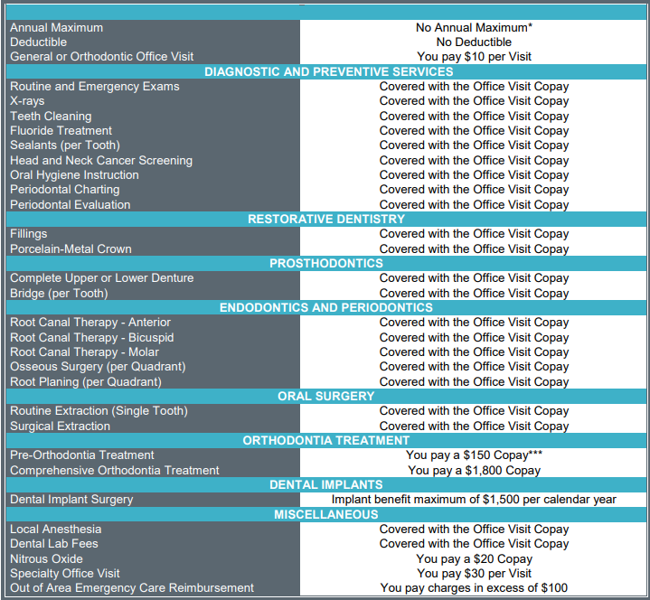
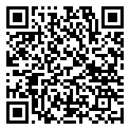
Dental
[ Overview ]
  Only Willamette Providers & Clinics
  No Annual Maximum
  No Deductible
  Most Office Visits covered with
$10 Copay
| Local Locations |
  Silverdale
  Tacoma

Slide 8
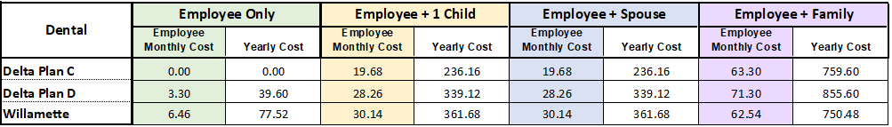
2024 Dental Rates

Slide 9
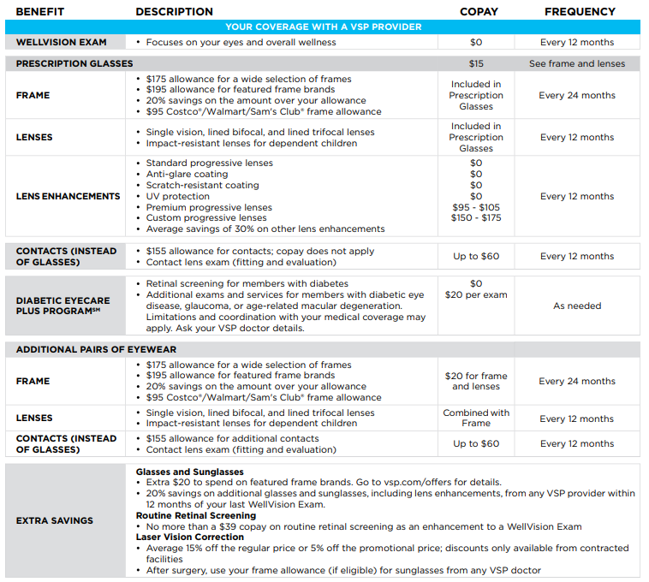


Vision
[Benefit Overview]
No premium charge for employee or dependents for Vision coverage, regardless of medical coverage enrollment
$0.00

Slide 10
2024 Vision Rates

Slide 11
Thanks for attending!
We're here to support you!
Alicia Hartnett | Benefits Analyst
ahartnet@kitsap.gov
Rikki Christensen | Benefits Coordinator rrchristensen@kitsap.gov

